Slide 1
Project Brief
DIGIT/R3/PO/2016/020 –DCCS Lot 1 –Compute Solutions(DCCS) – Lot 1

Slide 2
Title of the tender: DCCS lot 1
Illimited Liability ? NO
Start Date= 28/02/2017
End Start Up Process = 06/03/2017
End Submission bid questions = 14/04/2017
Submission Date = 24/04/2017
Validity of the offer = 24/01/2018
Duration of the contract:
for acquisitions of servers and associated equipment: four (4) years;
for leasing of servers and associated equipment: nine (9) years;
for extended guarantee, upgrades and associated services: nine (9) years;

Slide 3
Scope of the tender
The tenderer shall propose one model for each of the 5 server categories classified as:
Standard2 Sockets Blade Server
Standard 2 Sockets Rackable Server
Advanced 2 Sockets Rackable Server
Standard 4 Sockets Rackable Server
Advanced 4 SocketsRackable Server
Associated Equipment
Nternaldisks
Memory
Processors
Server accessories
Upgrade Kits
The tenderer shall also provide upgrade kits for the 5 configurations
Manufacturer Gurantee
tenderers shall describe the guarantee provided by the manufacturer which is included in the price of the purchase. This manufacturer guarantee shall apply to allcases where EUIs decide to only purchase the product, without purchasing one of the additional Extended Guarantee levels

Slide 4
Maintanance:
Standard Extended Guarantee(Level 1): This service includes the management of incidents, problems and changes during the Extended Guarantee period. The coverage hours of this service level is from 07.00 am to 08.00 pm.
Critical Extended Guarantee (Level 2): This service includes the management of incidents, problems and changes during the Extended Guarantee period. The coverage hours of this service level is 24/7 (24 hours per day, 7 days per week).
Professional Services:
The Contractors hall provide professional services on time and means, quoted time and means and a fixed price basis. The Framework Contract will cover the provision of the professional services required throughout the various phases of the lifetime of a server.
The following profiles will be required:
Project Manager
System Architect
IT Engineer

Slide 5
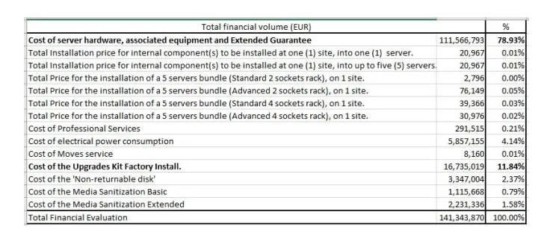
Value of the tender:
Estimation based on the quantity supplied in the tender:

Slide 6
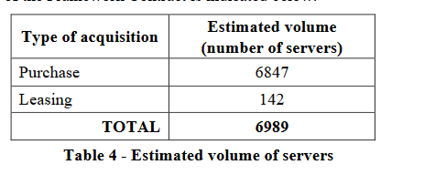
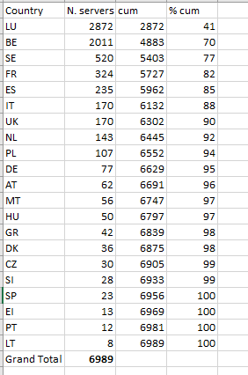
Volume by Country (supplier in the tender)

Slide 7
Liquidate Damages on Offers
For each working day of the Contractor's delay (3 working days from complete request) in providing a proposal or signing the Order Form, the Contractor shall, upon claim by the EUI, pay liquidated damages of 1% of the total amount of the Order Form, with a cap of 50% of the Order Form.
Liquidate Damages on Delivery:
For each working day of delay that goes beyond the Delivery Lead Time (6 weeks for servers, 3 weeks for options) and is due to the Contractor, the Contractor shall, upon claim by the EU Institution, pay liquidated damages of 5% of the total amount of the Order Form, with a cap of 50% of the Order Form.
Liquidate Damages on Extended Warranty:
For each server affected by an incident that was not resolved within the agreed incident resolution time for the Extended Guarantee level, liquidated damages will be calculated:
For each full hour that the resolution time of the incident is above the resolution time set, liquidated damages of 4 % of the yearly Extended Guarantee fee for an incident of priority 1 will apply.
For each full hour that the resolution time of the incident is above the resolution time set, liquidated damages of 1 % of the yearly Extended Guarantee fee for an incident of priority 2 will apply.
For each full hour that the resolution time of the incident is above the resolution time set, liquidated damages of 0.5 % of the yearly Extended Guarantee fee for an incident of priority 3 will apply.
For delays in the resolution of incidents of priority 4, no liquidated damages are due.
The liquidated damages for incident resolution time are capped at 200 hours. The conditions concerning the liquidated damages and the cap apply to every recorded incident.

Slide 8
Economic Selection Criteria:
Economic operators must have a minimum yearly average overall turnover of EUR 5,000,000 for the last three (3) financial years. This criterion applies to the tenderer as a whole, i.e. the combined capacity of all members of a group in case of a joint tender.
Technical Selection Criteria:
- A minimum amount of four (4) Project Managers, eight (8) System Architects and twelve (12) IT Engineers in your organisation;
- Minimum of three (3) references to similar provisions of goods and services (nature, volume) provided in the past three (3) years (including information on the amounts, dates and recipients; and including statements issued by its clients).

Slide 9
Financial Evaluation Criteria
The result of the financial evaluation will be a price figure representing the total cost of the offer over the whole duration of the Framework Contract, including:
• The cost of acquisition of the total estimated volume of server configurations with installation (90%) and without installation (10%) assuming the split between purchase and leasing;
• The cost of acquisition (purchase and leasing) of the estimated volume of the associated equipment (30% of (the cost of acquisition + the cost of Extended Guarantee));
• The cost of the total volume of Extended Guarantee by assuming the split between Standard and Critical Extended Guarantee;
• The cost of the estimated volume of professional services;
• The cost of power consumption (in accordance with EMAS principles) estimated to power the entire volume of servers for the operational life of five (5) years. The cost of electrical power consumption will be calculated based on:
• The power consumption [Watt] of the proposed configuration under idle load. The measurements are to be taken with all hardware components of the proposed configuration enabled and configured;
• The reference price of electrical power per kWh;
• The cost of the non-returnable disks;
• The cost of the estimated Disk Sanitization (Limited Basic and Limited High) service;
• The costs of estimated moves;
• The cost of the estimated upgrade kits.

Slide 10
Main Products to be produced in this tender
Technical Questionnaire provided in Annex 3 to the Tendering Specifications?
Financial Questionnaire and Model provided in Annex 6 to the Tendering Specifications?

Slide 11
Reference to previous tenders
BIT has never answered previously to a tender of this economic size.
However, this is a typical one winner, one catalogue tender. BIT has quite a lot of experience for in this kind of tender.
It is important to have an agressive price at the beginning of the contract and have a solid strategy for margin recovery during the exécution of the contract.
However, in this contract the presence of upgrade kit makes the recovery action more difficult.
Preparation.
BIT prepared a simulated recovery action model on the previous tender APSIII

Slide 12
Back to Back agreements.
BIT has closed a back to back agreement with XXXX for the supply of the items.
XXXX guarantee the best purchase price in EEC to BIT. A marginal risk of better price should be considered for bids outside EEC.
XXXX gurantee a rebate margin of 5% on all ordres related to this bid.
BIT has agreed a framework contract with Local Service Provider YYYY and ZZZZ for the exécution of services in Belgium and Luxembourg.

